Slide 1
Amazon sales analysis
presented by
tamilbharathi

Slide 2
introduction
Amazon is one of the world’s largest e-commerce platforms, generating massive amounts of sales data daily. Analyzing this data helps understand customer behavior, sales trends, top-performing products, and regional performance.
Power BI is a business intelligence and data visualization tool that transforms raw data into interactive dashboards and reports. It helps users explore data, identify insights, and make data-driven decisions quickly and effectively.
A Power BI dashboard can simplify analysis and provide actionable insights.

Slide 3
Problem statement
Amazon sales data is large and complex, making it difficult to analyse sales performance and identify meaningful patterns using traditional methods.
Without proper visualization and analysis, it becomes challenging to track sales trends, evaluate product performance, and make informed business decisions.
This project aims to address this problem by developing an Amazon Sales Analysis Dashboard using Power BI that converts raw sales data into interactive and insightful visualizations for effective analysis and decision-making.

Slide 4
questions
How is our overall sales performance trending over time, and are there identifiable peak periods or seasonal patterns?
Which product categories are driving the highest revenue, and which category is top performing.
Which individual products are our top performers.
How does sales performance vary across different cities, and which regions present opportunities for growth?
What is the distribution of orders by city, and how can we optimize logistics and delivery operations accordingly?
How are month-to-month sales changing, and what factors are contributing to growth or decline?
What payment methods do our customers prefer, and how can this inform payment strategy and customer experience improvements?

Slide 5
Data overview
Data Fields:
Order ID
Product Name & Category
Product ID
Units Sold & Quantity
Amount
Order Date
Customer Location
City ID
Payment method

Slide 6
Technology used
Data Source:
  Amazon Sales Dataset (Excel file)
Data Preparation & Transformation (ETL):
  Power Query: To clean, transform, and structure data
  Data Modeling: Creating tables like Calendar, Product, City, and linking relationship.
Data Analysis & Visualization:
  Power BI :
    Charts: Area chart, Bar chart, Column chart, Stacked area chart, Donut chart.
    Measures using DAX.
Data Insights & Reporting:
  Power BI Dashboard: Interactive visualizations for executives
  Filters & Slicers: To analyze sales by category, product, city, month, and payment method

Slide 7
Data preprocessing
The Best Tool For Cleaning And Preprocessing The Data Is Called As Power Query Editor.
It Is Used For Extracting The Data, Transforming The Data And Loading Into Power Bi.
Data Cleaning steps :
Changing the data type of order ID from number to text.
Append the two year(2024,2025) data into one using append queries.
Extract month, month name, day and year from order date.
Segregate the product column and product ID and creating a separate table.
Segregate the city column and city ID for creating a city table.
Removing the duplicate values.

Slide 8
Key metrics and kpi’ s
Total Sales: $216M
Total Orders: 2K
Total Quantity Sold: 7K
These KPIs give a quick snapshot of business performance.

Slide 9
Dax Measures used
Dax is called as Data Analytic Expression.
DAX is a formula language used in Power BI.
To perform calculations and data analysis.
Measures:
Total Sales = SUM('Amazon sales'[Total_Sales])
Total Orders = DISTINCTCOUNT('Amazon sales'[Order_ID])
Total Quantity Sold = sum('Amazon sales'[Quantity])

Slide 10
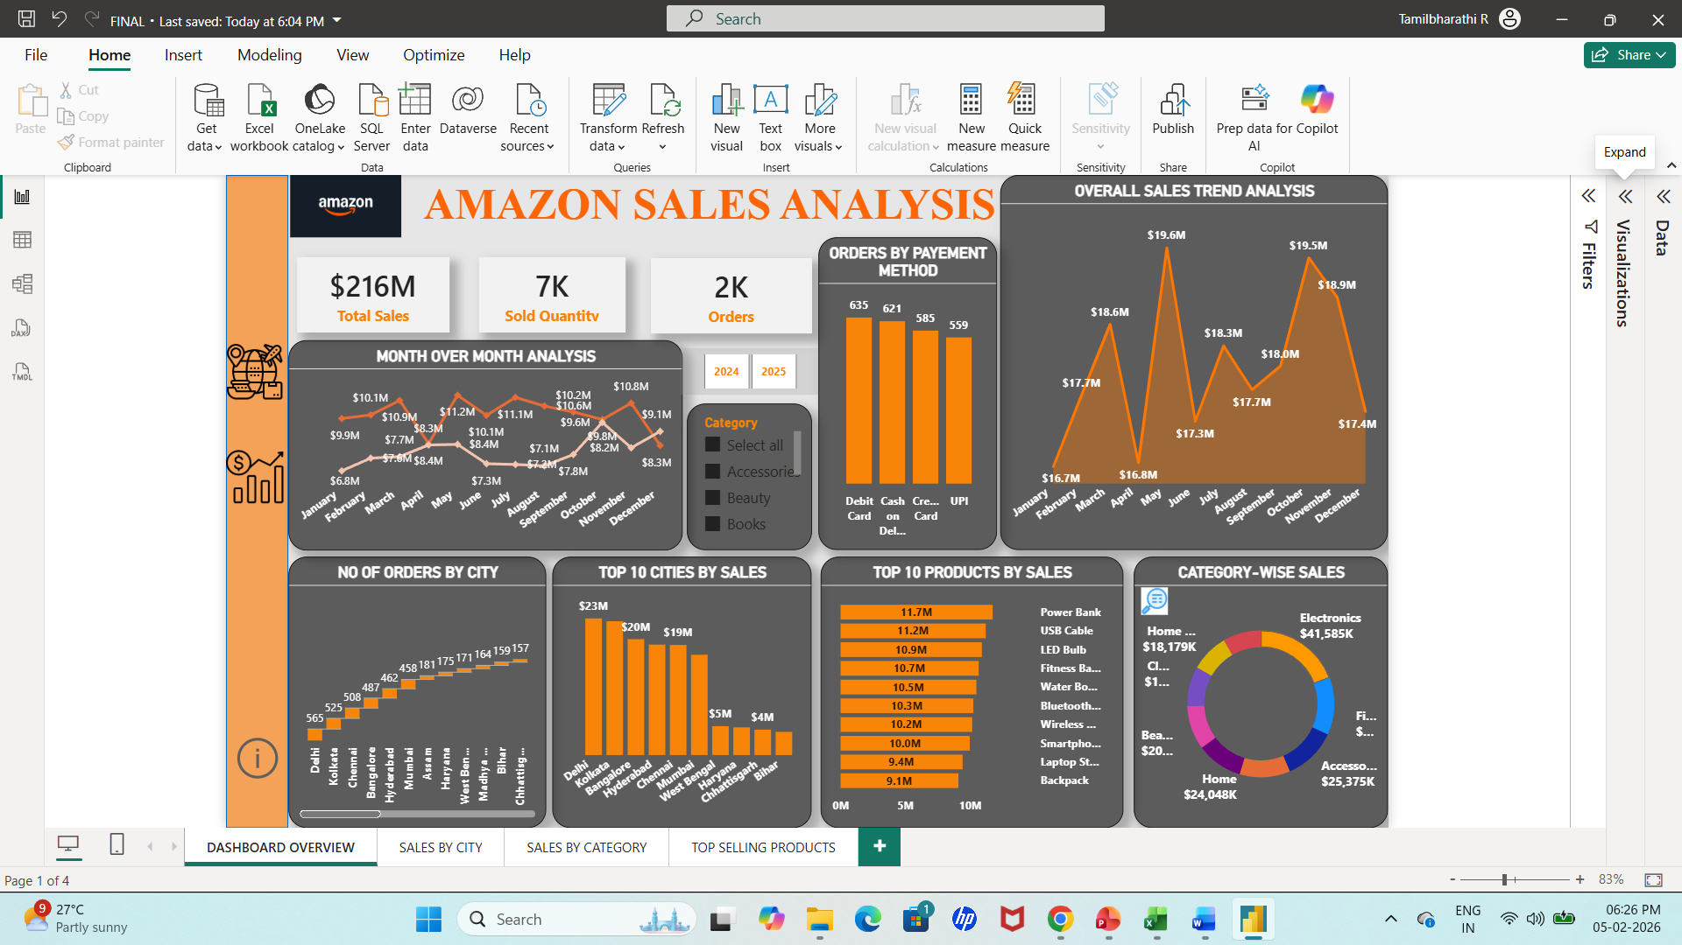
Power bi dashboard overview

Slide 11
overall sales trend analysis
Area Chart: It clearly shows total sales over time and allows you
to see growth patterns and peaks.
X-axis: Months (Jan → Dec)
Y-axis: Total Sales ($)

Slide 12
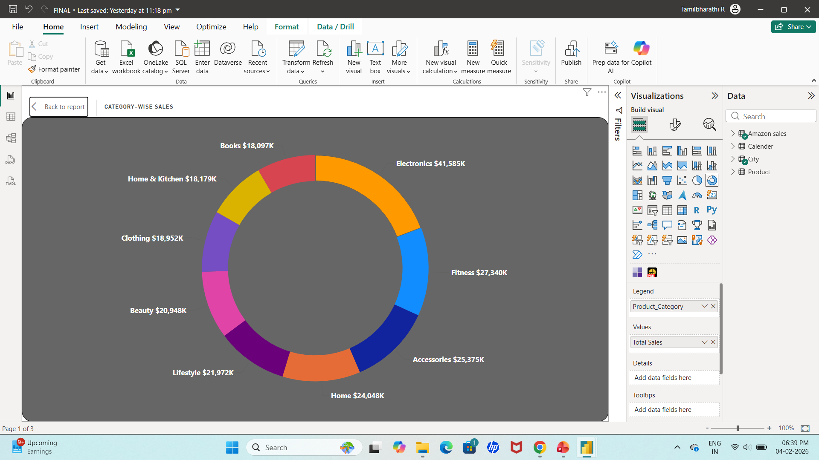
Top selling category based on sales
Donut chart→ Shows Percentage contribution of each category to total revenue
Legend: category
Values: percentage of total revenue

Slide 13
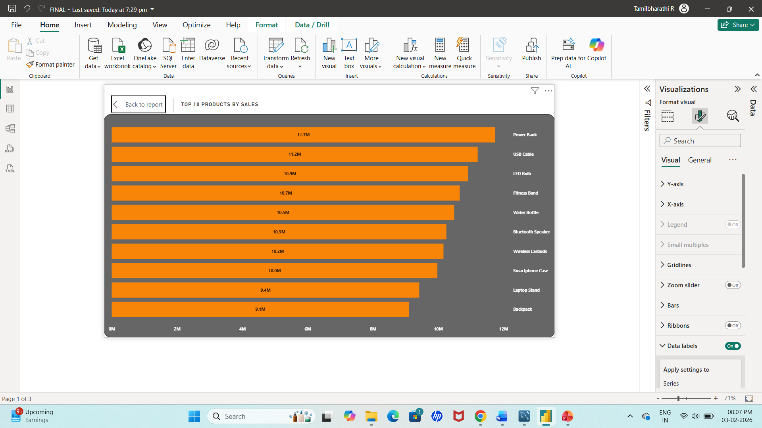
Identify Top 10 products by sales
Stacked bar chart→ horizontal bars are easier to read, it gives quick comparison across products.
Y axis: product name
X axis: Sum of total sales

Slide 14
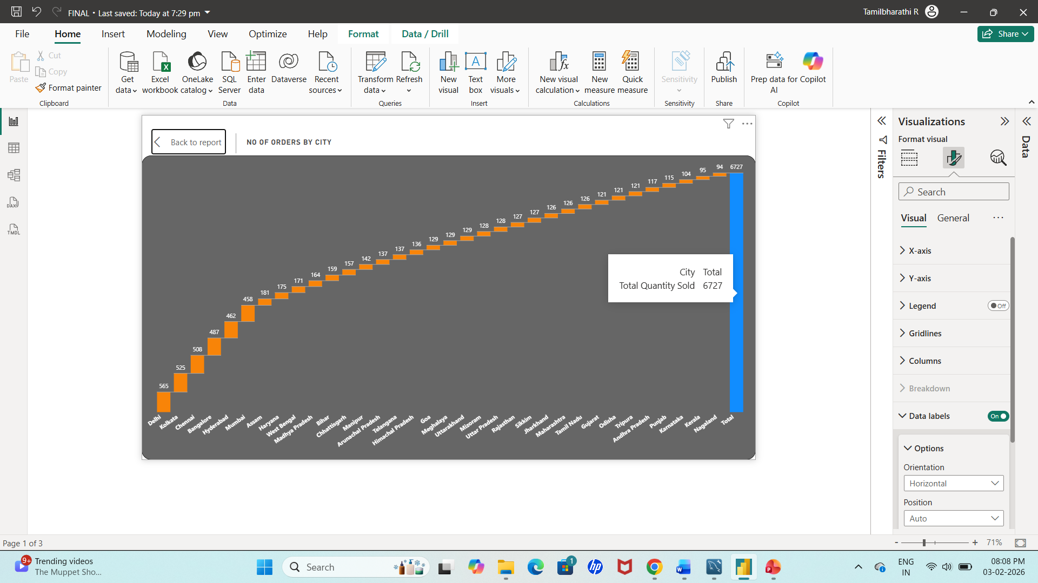
Identify orders by each city
Waterfall chart: Shows customer demand and order volume across cities.
X-Axis: City Name
Y-Axis: Number of Orders

Slide 15
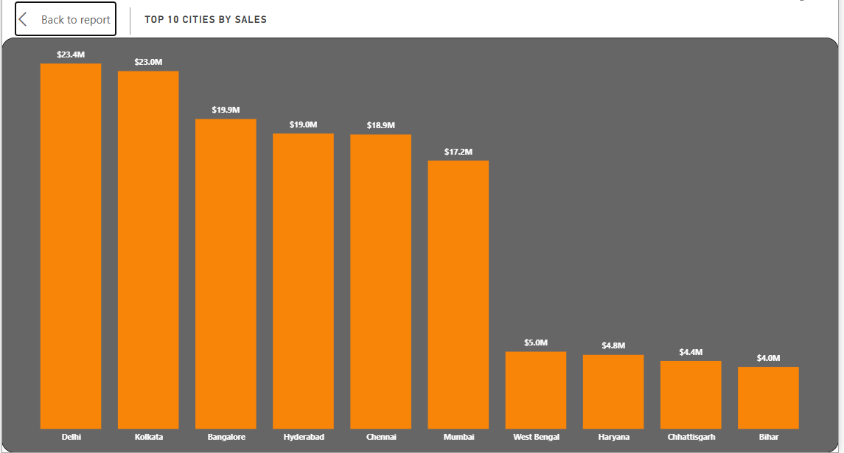
Analyse city-wise sales trend
Vertical Bar Chart: Identifies cities generating the highest sales.
X-Axis: City Name
Y-Axis: Total Sales Amount

Slide 16
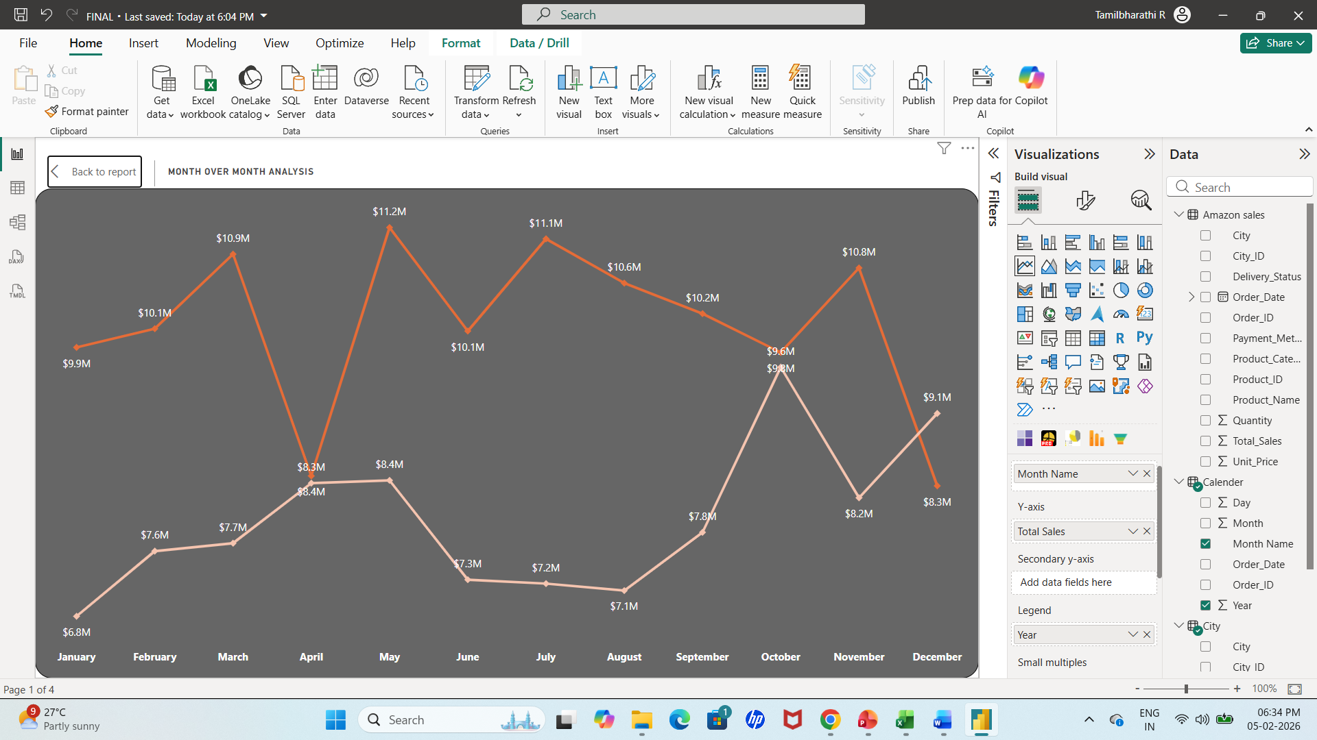
Month over month analysis
Line Chart: These Charts are used to show the trends over months
X axis: Month Name
Y axis: Total Sales
Legend: year

Slide 17
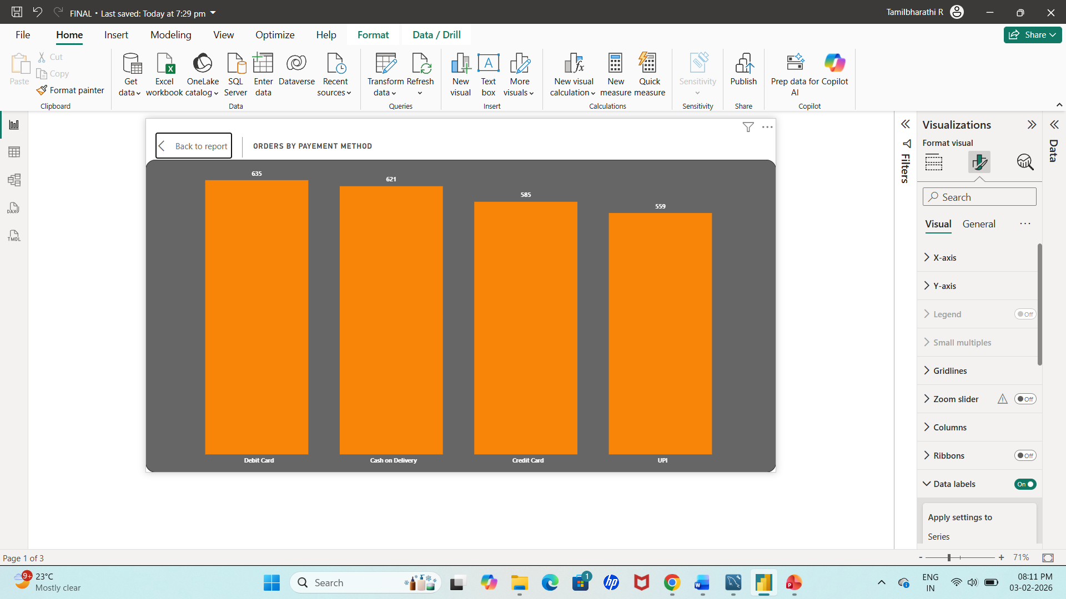
Identify orders based on payment method
Bar Chart: Analyzes customer payment preferences.
X-Axis: Payment Method (Debit Card, Credit Card, UPI, Cash on Delivery)
Y-Axis: Number of Orders

Slide 18
conclusion
The Amazon Sales Dashboard In Power BI Provides A Comprehensive View Of Sales Trends, Product Performance, And Regional Insights, Enabling Data-driven Decisions And Optimized Business Strategies.
The Amazon Sales Analysis provides a clear understanding of sales performance across products, categories, and regions.
This analysis equips decision-makers with data-driven insights to improve sales strategy, inventory management, and overall business performance.

Slide 19
Thank you

